Slide 1
Tuneable tri-Band three slot antenna configuration
Kei Hong Chan

Slide 2
Three Slot antenna
For Phone and tablet 4G(LTE)
Able to tune at 0.6-2.7GHz (3.4-3.6 GHz is in consideration)
First slot : 0.6-0.96GHz
Second Slot: 1.5-2.2GHz
Third Slot 2.2-2.6GHz
These frequency band also can use for WIFI(2.4GHz), Bluetooth(2.4GHz), GPS (1.55 GHz) etc.

Slide 3
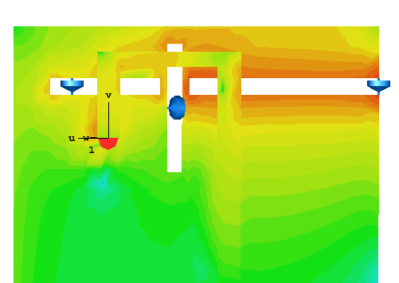
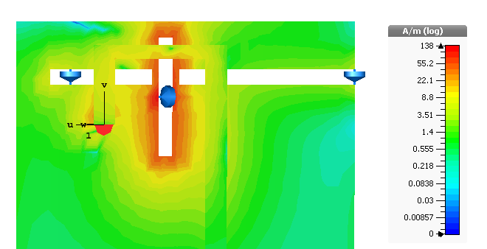
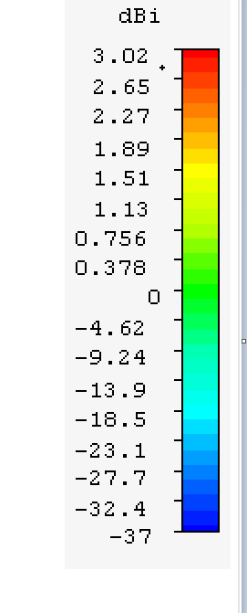
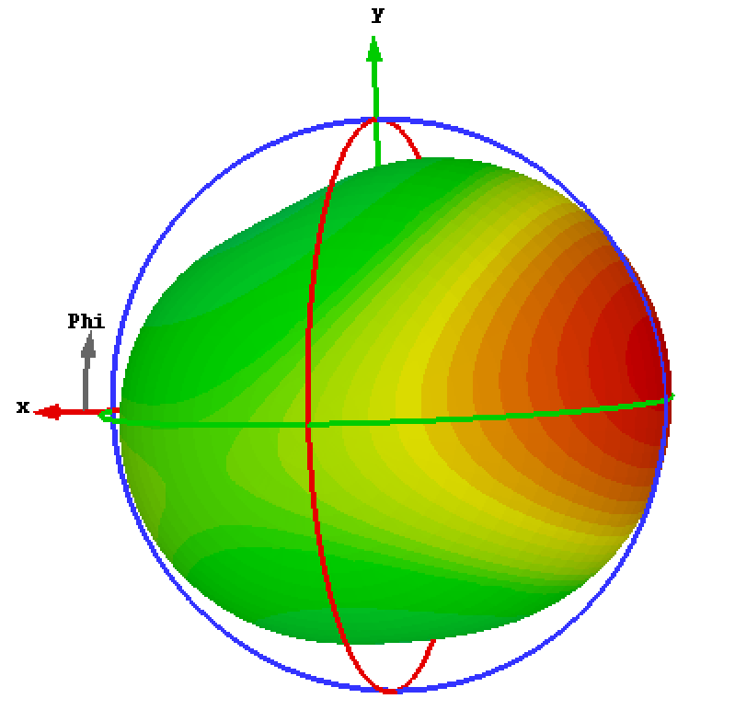
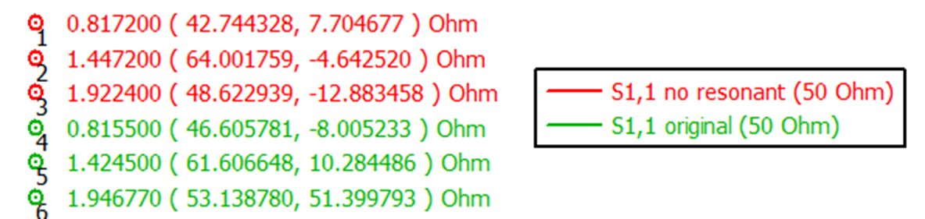
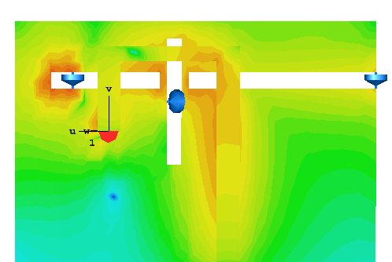

Slide 4
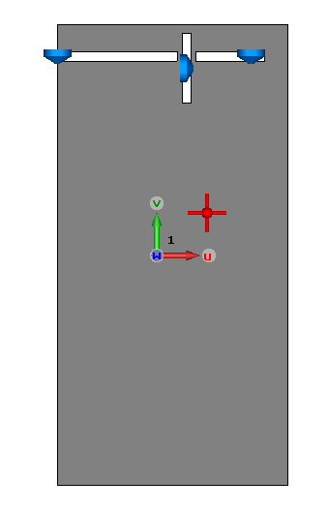
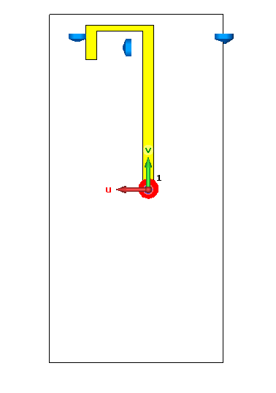
Aim
50mm
Why using slot antenna?
Simple structure
First slot
Easily embedded to the PCB
Second slot
100mm
Third slot
Improve the prototype design
Micro strip line
Resonant Frequency
Size
Operation range
Keep the design simple

Slide 5
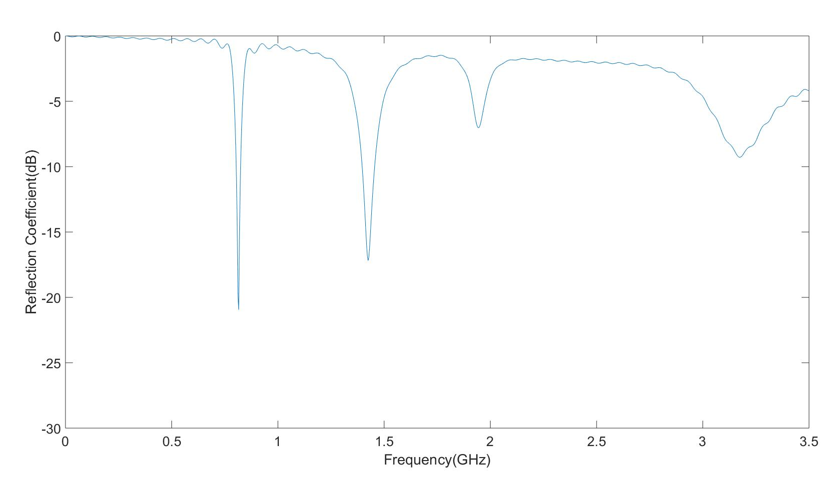
50mm
Reflection Coefficient on the prototype
100mm
Working zone but have loss
Working zone
First slot resonant frequency (second harmonic)
Slot antenna radiant frequency

Slide 6
Three difference design for this prototype
First Design: Antenna with filter
Second design: Antenna with reflector
Third design: Folded slot antenna

Slide 7
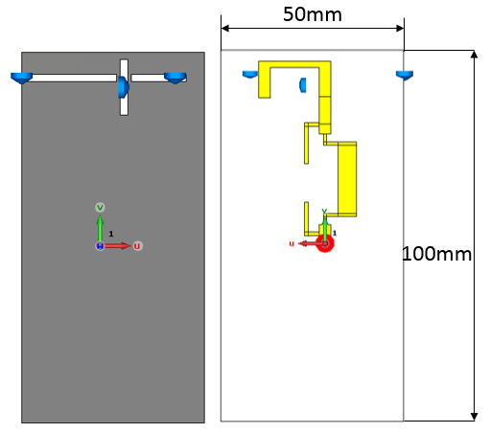
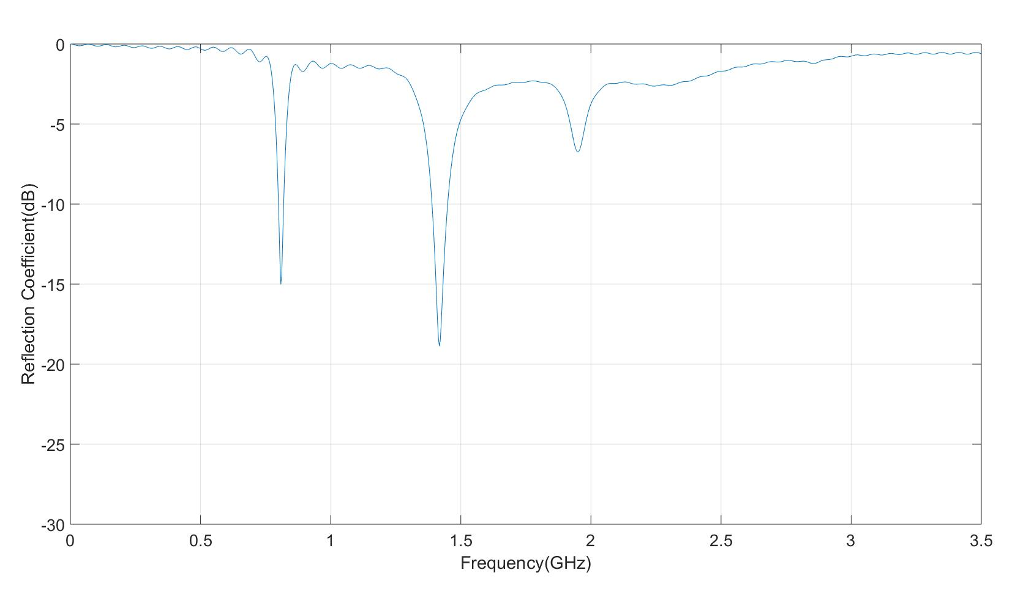
First Design: Antenna with filter
Filter the frequency >2GHz
Signal is filtered
Filter
Working zone but have loss
Working zone
These signal are kept

Slide 8
Is that good enough?
Filter the signal
λ/2
Frequency limited <2GHz
Filter size
Complex design

Slide 9
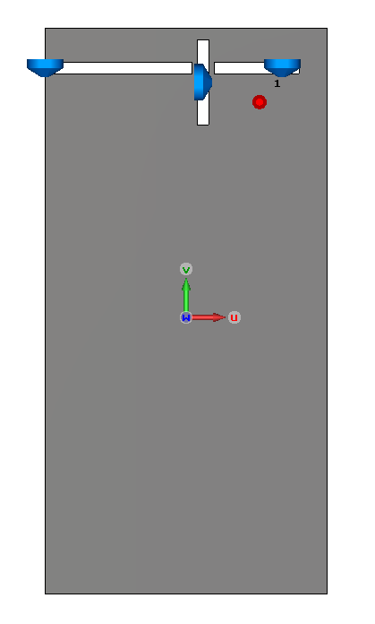
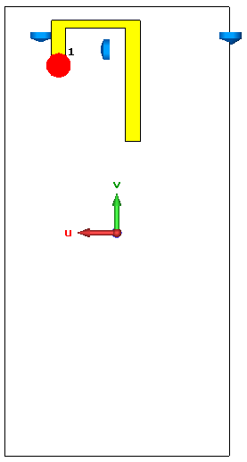
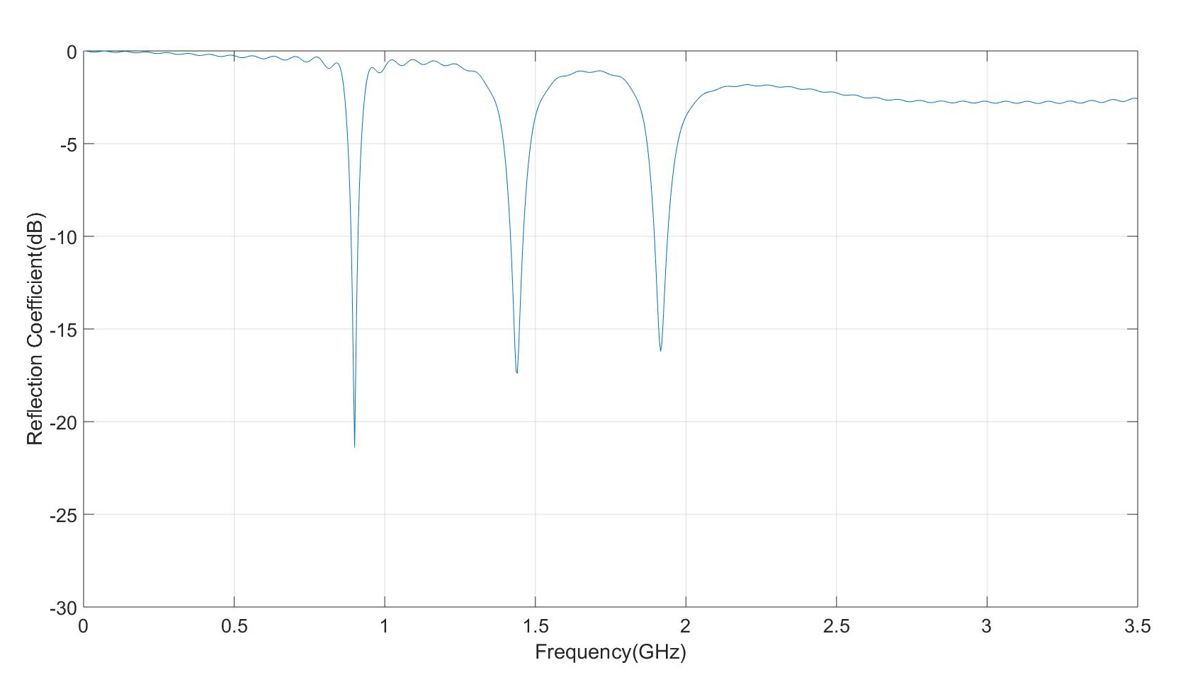
50mm
Second Design: reflector
50mm
The feeding point is swapped
End of the strip line and the first slot distance = approximate λ/2 3-3.6GHz
Signal cannot feed first slot
100mm
100mm
This actually a reflector.
Working zone but have lose
Working zone
Three slot resonant point

Slide 10
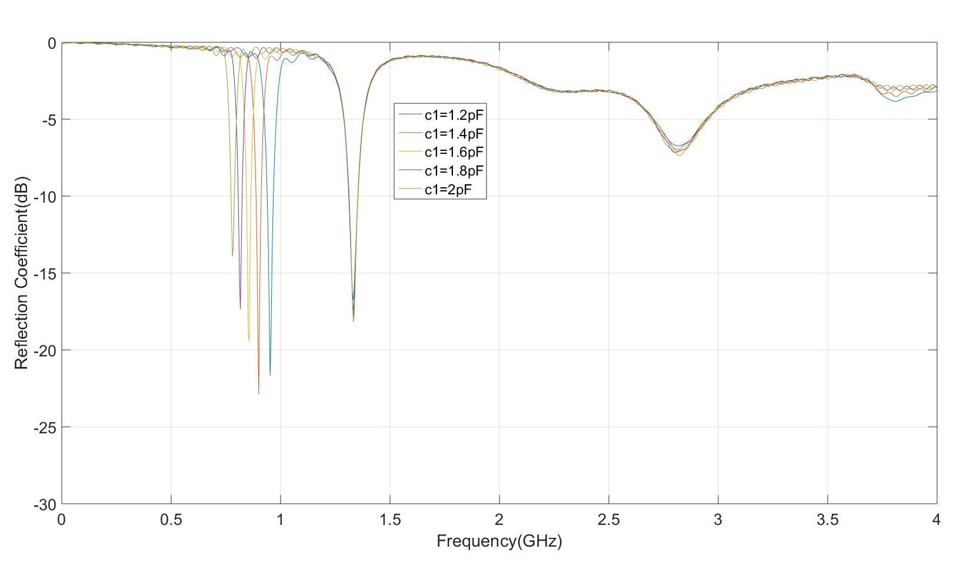
First Slot 0.6-0.96GHz
Predicted tuneable range

Slide 11
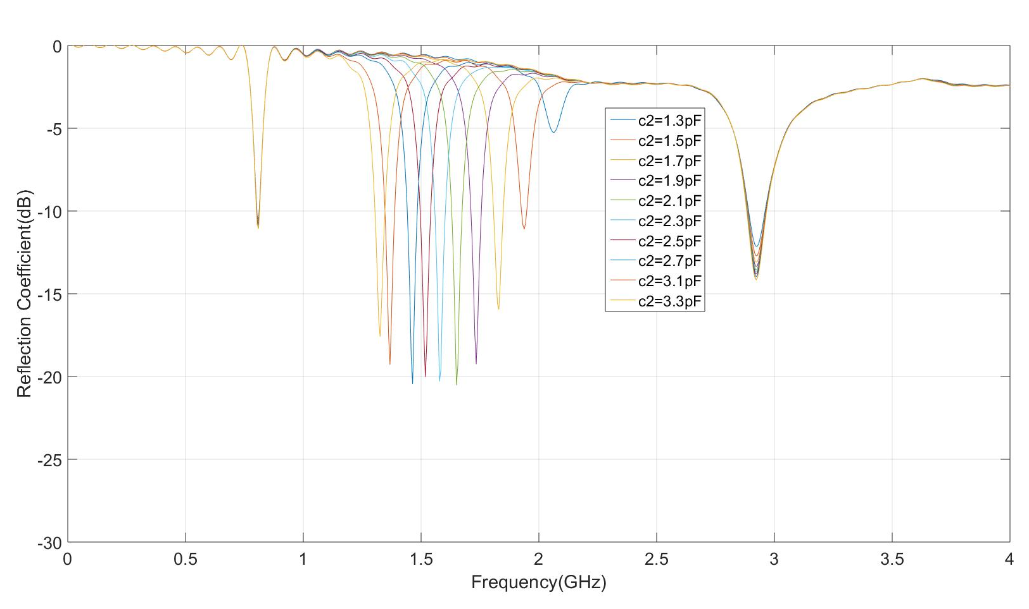
Second Slot 1.5-2.6GHz
Predicted tuneable range

Slide 12
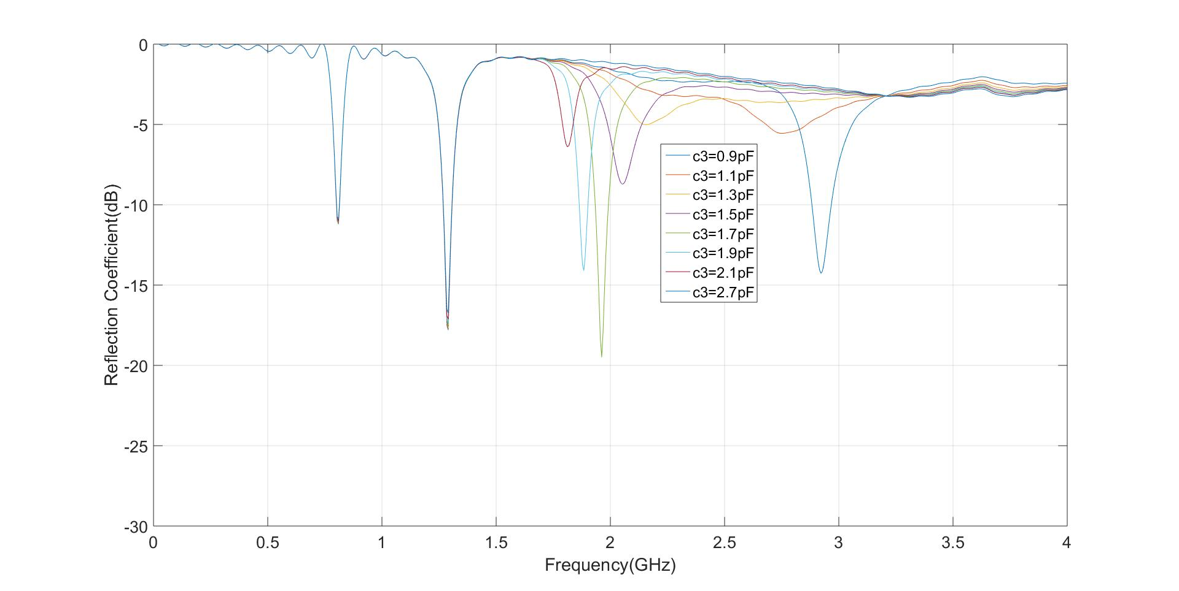
Third Slot 1.5-2.6GHz
Predicted tuneable range

Slide 13
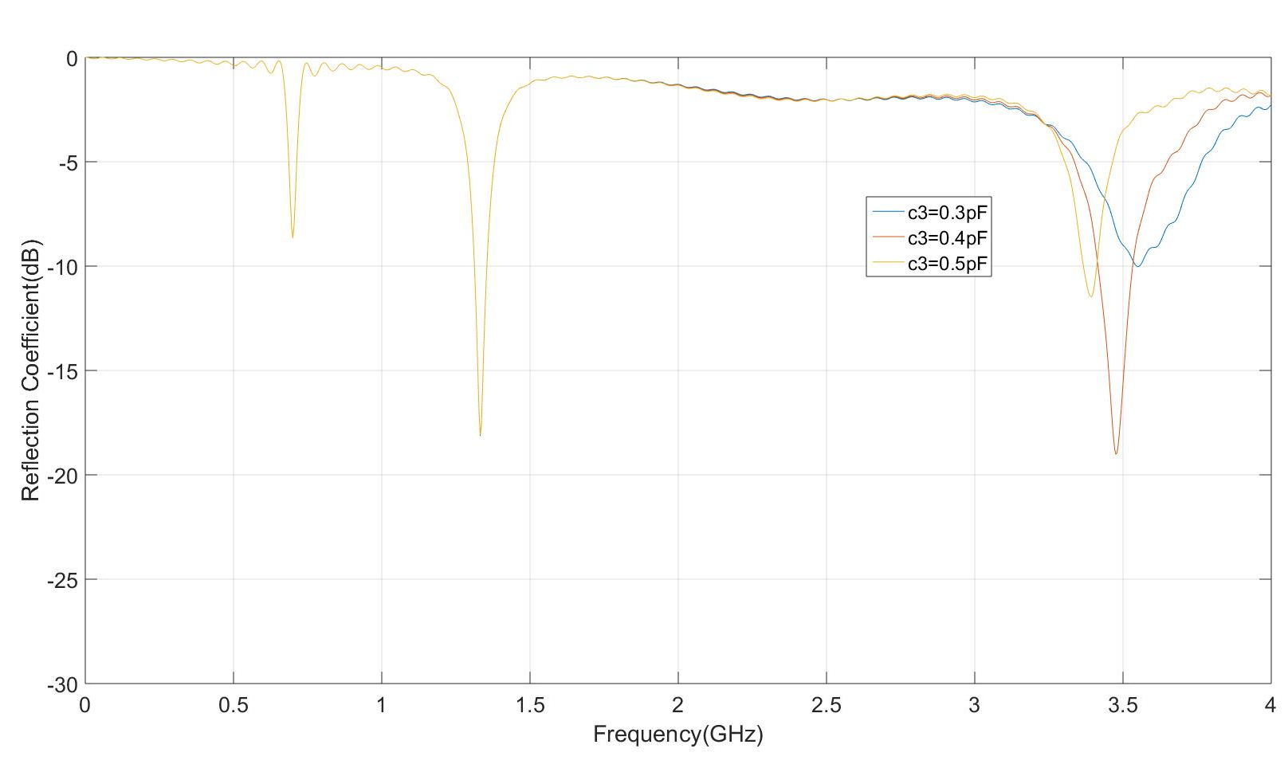
Third Slot 3.4-3.6GHz
Predicted tuneable range

Slide 14
Does it work?
Simple design
λ
Size is smaller
λ/2
Resonant point is removed
λ/2
Part of tuneable range
Can the strip line be even smaller?

Slide 15
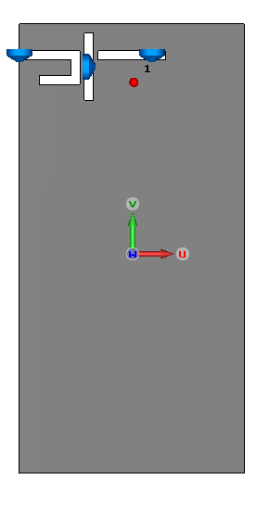
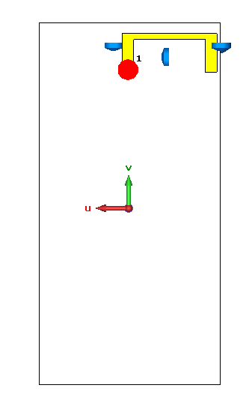
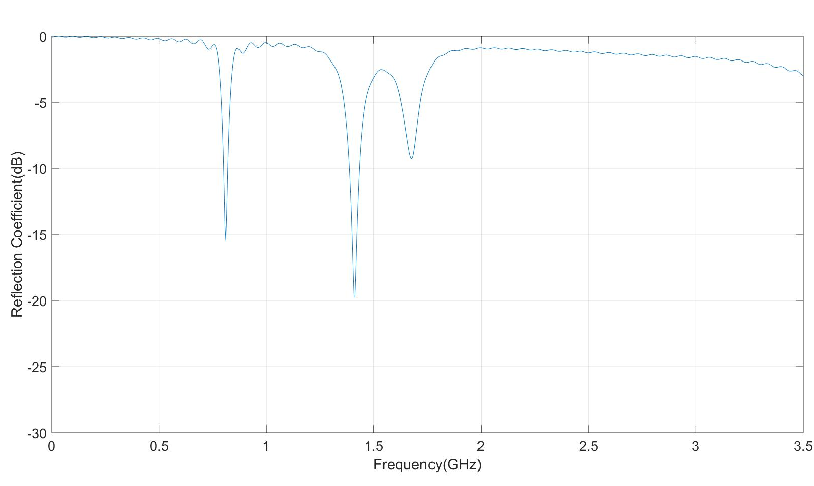
50mm
Third Design : Folded slot
Resonant frequency point shifted
Less space is occupied
First slot is folded
100mm
Working zone but have loss
Working zone
Those are working

Slide 16
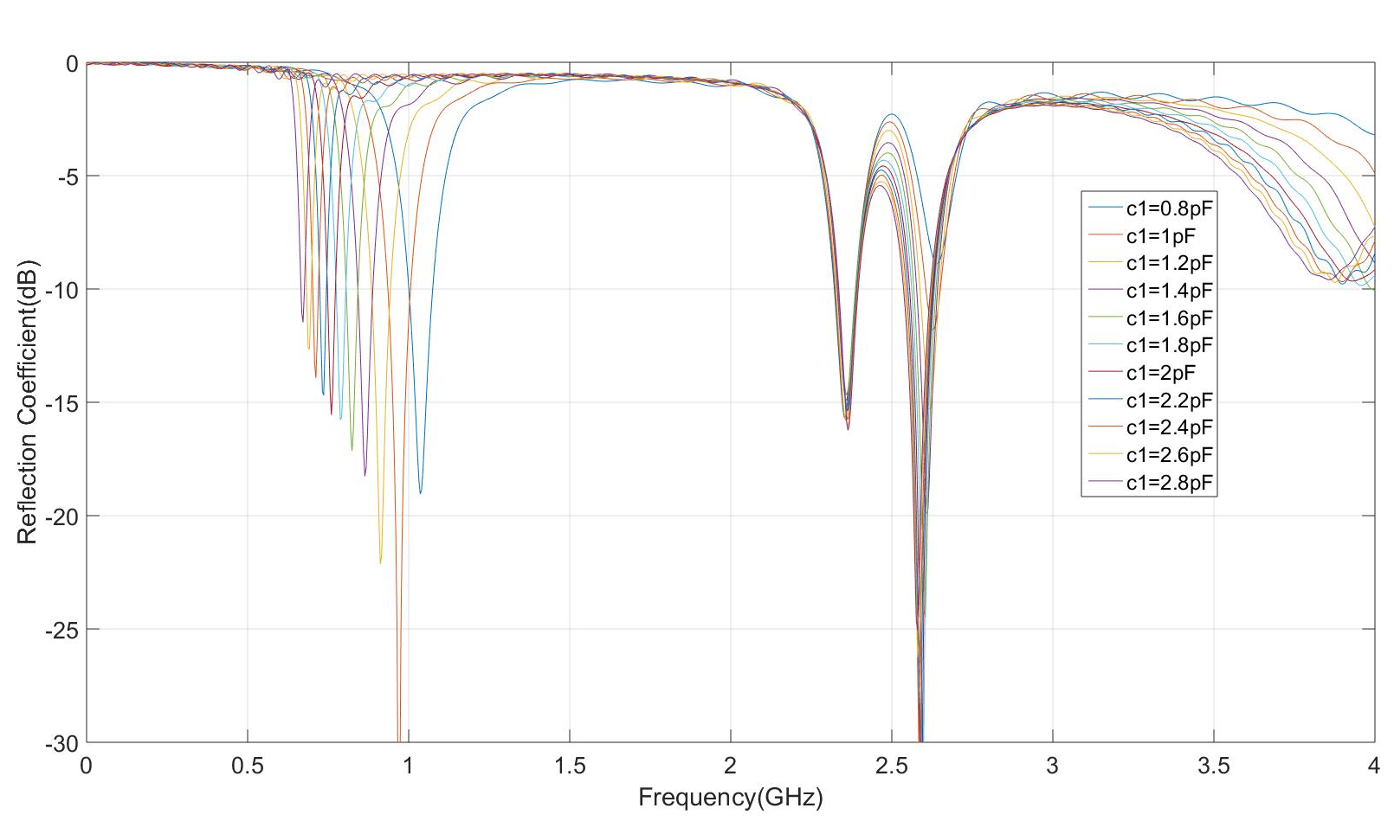
First slot
Predicted tuneable range

Slide 17
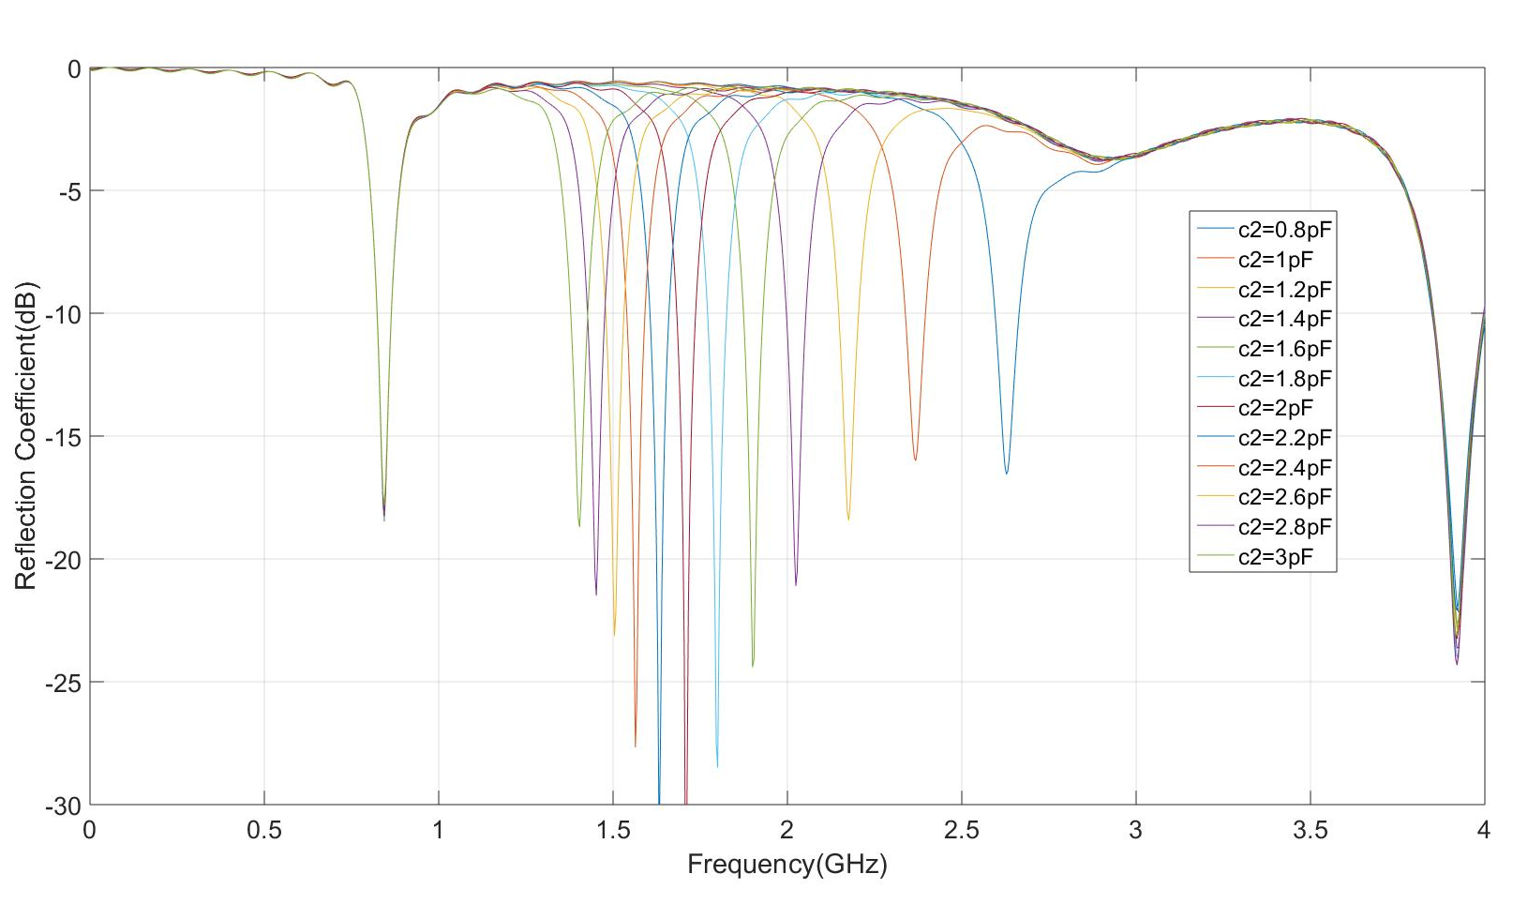
Second Slot
Predicted tuneable range

Slide 18
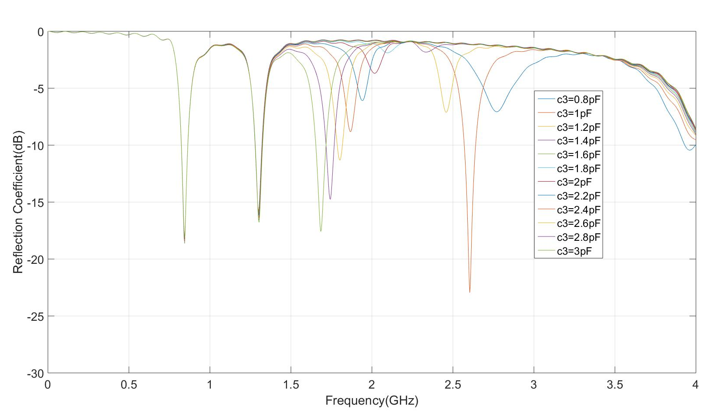
Third Slot
Predicted tuneable range

Slide 19
Conclusion of the third design
Operation range is better than Second Design
50mm
Size is smaller
Resonant frequency shifted out
100mm

Slide 20
Summary
Design compare
First
Second
Third
Size:
larger
Smaller
Smallest
Signal:
filtered
/
Cancelled
Shifted (may back)
Complexity:
Complex
Simple
Simple
Tuneable:
<2GHz
No antenna can radiant at 2-2.2GHz
The third slot cannot work at 1.9-2.5GHz

Slide 21
Any Questions?

Slide 22
Addition information: Possibility adjustment
Rotate the third slot
Design a smaller slot (when 1pF)
Large capacitance(>1pF) will better to tune than a tiny capacitance(<1pF)

